Slide 1

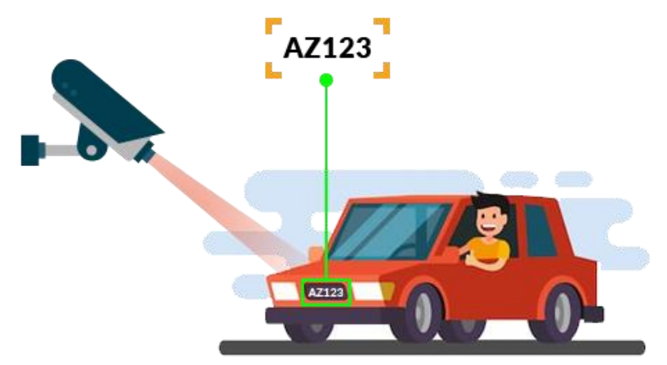
ADVANCED ANPR & FRS SOLUTION
KVH-005

Slide 2
TEAM / PROBLEM STATEMENT:
PSID : KVH-005
Problem statement : Advanced ANPR & FRS Solution.
Team Name : [NAS]^2
Team Leader : Abarajith S
Team Members : Abarajith S, Nakshatiraa K N, Navin R C, Shree Niranjana M, Arvind M, Shriram V
Institute Name : Shiv Nadar University, Chennai.

Slide 3
IDEA
This ANPR solution and FRS include software that runs on either the camera or a server. It automatically captures license plates in real time. Relying on well trained deep-learning models, the ANPR engine includes following features:
Multilingual Recognition Recognizes English, Hindi, Tamil, Telugu and other Indian languages.
AI Based vehicle attributes recognition like vehicle type, colour.
Fast and High Recognition Rate with alphanumeric number plates
Works in harsh weather conditions.
Multiple lane operation
Detects Over speeding and sends automated warnings
Vehicular Tracking
Updates date, time and location of the captured vehicle
Cost-effective Technology
Procure data from cameras anywhere
1
2
3
4
5
Facial Recognition
Number plate detection
Character Recognition
Vehicle image capture
Character Segmentation

Slide 4
PROCESS:
1)Pre-processing:
(1)Convert color image to grayscale
(2) Remove the noises in it
2) Plate Localization:
(1) Edge Detection
(2) Number Plate Isolation
(3) Number Plate Orientation and Sizing: resize the isolated number plate by removing the border around the plate.
3) Character Segmentation
4) Character Recognition
DEPENDENCIES:
Operating System: ANPR software requires a specific operating system (OS) such as Windows, Linux or MacOS, which needs to be installed on the computer or server that will run the software.
Programming Language: Python IDE like Spyder or Jupyter Notebook.
Data Processing Libraries: Keras, Tensorflow.
Image Processing Libraries: OpenCV, EasyOCR, imutils, dlib and face_recognition.
Camera Interface: ANPR software needs to interface with cameras to capture images of the number plates.
Database Management System(storage): ANPR software needs a database to store the number plate images and associated metadata like MySQL and MongoDB or even cloud storage for datasets.
Network Interfaces: ANPR software may require network interfaces to communicate with other systems or devices, for example, sending notifications to a security system or communicating with a cloud-based service.

Slide 5
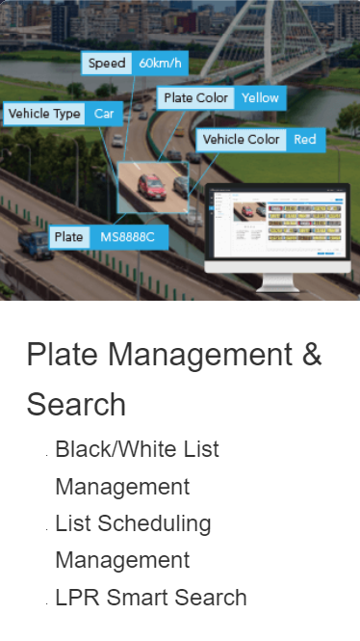
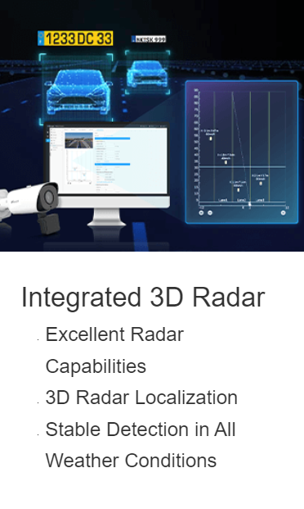
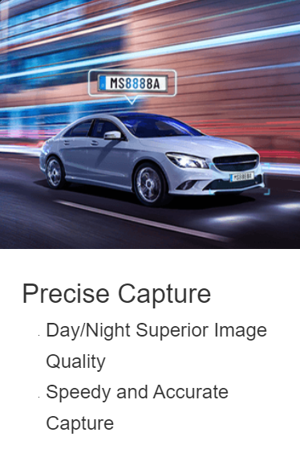
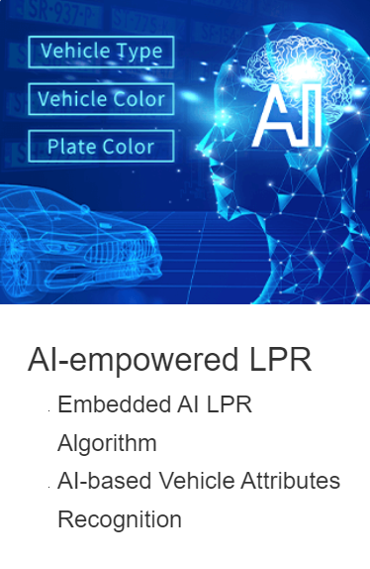
USE CASE
SHOW STOPPER
Road Safety Enforcement :
Automatically recognizes speeding and red-light violations and notifies the driver and to the nearby police authority.
Law Enforcement :
Verifies vehicle license and registration. Provides an automatic alert when blacklisted vehicles passes by. Detects duplicate licence plates. Provides lines of enquiry and evidence in the investigation of crime.
Smart City Management :
With the increasing demands on our city infrastructure, Intelligent ANPR is seen as a way to manage transport resources more effectively. ANPR technology is becoming increasingly important and can provide significantly more information than simple traffic counters.

